Slide 1
PGVCL Training
Day-11

Slide 2
Flutter Training for PGVCL Department
Day 11 : Flutter Web Development and Generative Code

Slide 3
Overview
Topics We’ll Be Covering For Today
Theory
Basics of flutter for the web
Using code generation tools
(e.g. JSON serialization)
Practical
Create a basic web app and auto-generate models for API responses
Assignment
Add interactive forms to the web app and serialize data.

Slide 4
Objectives
Understand the basics of Flutter for web development.
Learn about code generation and its role in Flutter applications.
Build a basic Flutter web app and auto-generate models for API responses.
Extend functionality by adding interactive forms and data serialization.

Slide 5
Basics of Flutter for the Web
What Is Flutter for Web?
Flutter web allows developers to build responsive and rich web apps using the same codebase as mobile apps.
Supports rendering through HTML, CSS, and CanvasKit.
Key Features:
Single Codebase: Write once, deploy across mobile, desktop, and web.
Responsive Design: Adapts to various screen sizes and orientations.
Web-Specific Widgets: Widgets like SelectableText enhance the web experience.

Slide 6
Web-Specific Widgets: Widgets like SelectableText enhance the web experience.
SEO Optimization: Add metadata and descriptions for better search engine visibility.

Slide 7
Benefits of Flutter for Web
Faster Development: Reuse existing Flutter knowledge and codebase.
Cross-Platform Consistency: Maintain uniformity across platforms.
Rich Animations: Flutter's animation libraries make interactive web apps seamless.
WebAssembly Support: Leverages CanvasKit for enhanced performance.

Slide 8
Code Generation in Flutter
What Is Code Generation?
Automates the creation of boilerplate code, saving time and reducing human error.
Commonly used for:
JSON Serialization: Generating model classes from JSON responses.
Route Management: Managing navigation dynamically.
Form Validation: Generating validation rules.

Slide 9
Tools for Code Generation:
build_runner: Core tool for running code generation scripts.
json_serializable: Generates JSON model classes automatically.
freezed: Creates immutable model classes with minimal boilerplate.

Slide 10
Practical: Create a Flutter Web App
Objective: Build a basic Flutter web app that fetches API data and uses generated models.
Steps:
Set Up the Web Project:
Enable web support in Flutter.
flutter create my_web_app --platforms=web.
Fetch API Data:
Use http package to fetch data from a REST API.

Slide 11
Generate Models:
Use json_serializable to auto-generate Dart classes for API responses.
Add Interactive Features:
Implement a search bar, filters, or dynamic lists.

Slide 12
Adding Interactive Forms and Serialization
Interactive Forms:
Use TextFormField and Form widgets to capture user inputs.
Validate data with TextInputFormatter or custom validation rules.
Serialization:
Serialize form data into JSON format for storage or API submission.
Use json_serializable to streamline the serialization process.

Slide 13
Best Practices for Web and Code Generation
Flutter Web Development:
Test on multiple browsers for compatibility (Chrome, Firefox, Edge).
Optimize assets for faster load times.
Code Generation:
Regularly update and clean generated files to avoid redundancy.
Use strong typing for better maintainability.
Responsive Design:
Use LayoutBuilder and MediaQuery to adapt UI elements to various screen sizes.
Debugging:
Use browser developer tools alongside Flutter's debugging tools.

Slide 14
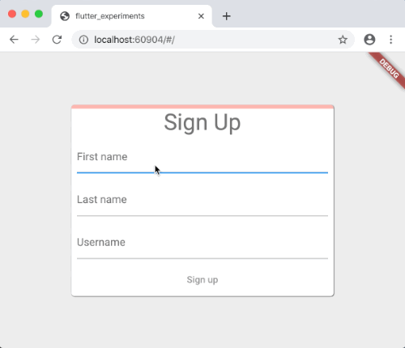

Slide 15
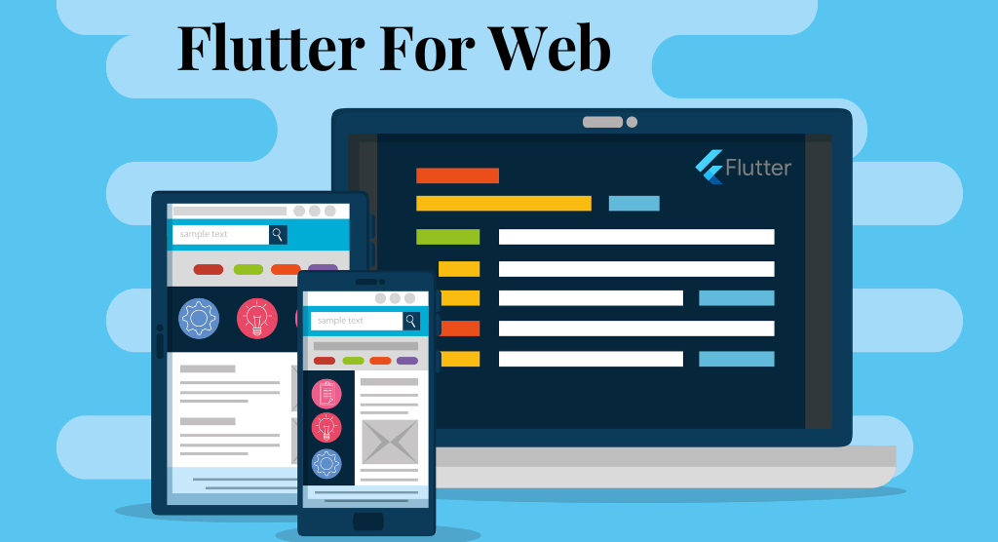

Slide 16
Practical Example
Link
Assignment Example
Create a basic UI with 3 Stateless Widgets and 2 Stateful Widgets

